Slide 1
Software Quality Engineering
TESTING:
CONCEPTS, ISSUES, AND TECHNIQUES
Lecture 4
Spring 2023

Slide 2
PURPOSES, ACTIVITIES, PROCESSES, AND CONTEXT
Testing: Why?
Similar to the situation for many physical systems and products, the purpose of software testing is to ensure that the software systems would work as expected when they are used by their target customers and users. The most natural way to show this fulfillment of expectations is to demonstrate their operation through some “dry-runs” or controlled experimentation in laboratory settings before the products are released or delivered. In the case of software products, such controlled experimentation through program execution is generally called testing.
Because of the relatively defect-free manufacturing process for software as compared
to the development process, we focus on testing in the development process. We run or execute the implemented software systems or components to demonstrate that they work as expected. Therefore, “demonstration of proper behavior” is a primary purpose of testing, which can also be interpreted as providing evidence of quality in the context of software QA, or as meeting certain quality goals.

Slide 3
PURPOSES, ACTIVITIES, PROCESSES, AND CONTEXT
To summarize, testing fulfills two primary purposes:
  to demonstrate quality or proper behavior;
  to detect and fix problems.

Slide 4
Major activities and the generic testing process
The basic concepts of testing can be best described in the context of the major activities involved in testing. Although there are different ways to group them (Musa, 1998; Burnstein, 2003; Black, 2004), the major test activities include the following in roughly chronological order:
Test planning and preparation, which set the goals for testing, select an overall testing strategy, and prepare specific test cases and the general test procedure.
Test execution and related activities, which also include related observation and measurement of product behavior.
Analysis and follow-up, which include result checking and analysis to determine if a failure has been observed, and if so, follow-up activities are initiated and monitored to ensure removal of the underlying causes, or faults, that led to the observed failures in the first place.

Slide 5
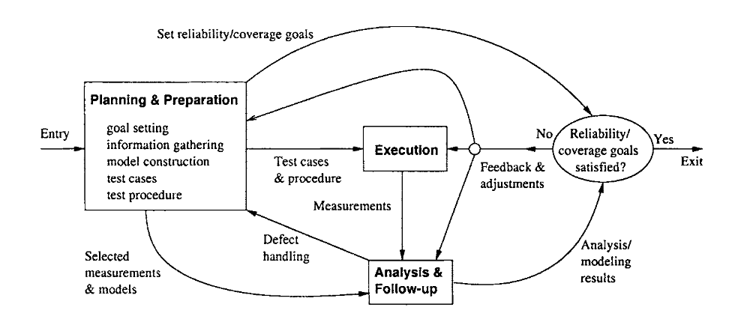
Generic testing process

Slide 6
Sub-activities in test planning and preparation
Goal setting: This is similar to the goal setting for the overall quality engineering process described in Chapter 5. However, it is generally more concrete here, because the quality views and attributes have been decided by the overall quality engineering process. What remains to be done is the specific testing goals, such as reliability or coverage goals, to be used as the exit criteria.
Test case preparation: This is the activity most people naturally associate with test preparation. It includes constructing new test cases or generating them automatically, selecting from existing ones for legacy products, and organizing them in some systematic ways for easy execution and management. In most systematic testing, these test cases need to be constructed, generated, or selected based on some formal models associated with formal testing techniques.
Test procedure preparation: This is an important activity for test preparation. For systematic testing on a large scale for most of today’s software products and software intensive systems, a formal procedure is more of a necessity than a luxury. It can be defined and followed to ensure effective test execution, problem handling and resolution, and the overall test process management.

Slide 7
Testing as a part of QA in the overall software process
In the overall framework of software quality engineering, testing is an integral part of the QA activities. In our classification scheme based on different ways of dealing with defects, testing falls into the category of defect reduction alternatives that also include inspection and various static and dynamic analyses. Unlike inspection, testing detects faults indirectly through the execution of software instead of critical examination used in inspection.

Slide 8
What artifacts are tested?
The primary types of objects or software artifacts to be tested are software programs or code written in different programming languages. Program code is the focus of our testing effort and related testing techniques and activities.

Slide 9
What to test, and what kind of faults is found?
Black-box (or functional) testing verifies the correct handling of the external functions provided or supported by the software, or whether the observed behavior conforms to user expectations or product specifications. White-box (or structural) testing verifies the correct implementation of internal units, structures, and relations among them.
When black-box testing is performed, failures related to specific external functions can be observed, leading to corresponding faults being detected and removed. The emphasis is on reducing the chances of encountering functional problems by target
customers.
On the other hand, when white-box testing is performed, failures related to internal implementations can be observed, leading to corresponding faults being detected and removed. The emphasis is on reducing internal faults so that there is less chance for failures later on no matter what kind of application environment the software is subjected to.

Slide 10
When, or at what defect level, to stop testing?
Most of the traditional testing techniques and testing sub-phases use some coverage information as the stopping criterion, with the implicit assumption that higher coverage means higher quality or lower levels of defects. On the other hand, product reliability goals can be used as a more objective criterion to stop testing.
The coverage criterion ensures that certain types of faults are detected and removed, thus reducing the number of defects to a lower level, although quality is not directly assessed.
The usage-based testing and the related reliability criterion ensure that the faults that are most likely to cause problems to customers are detected and removed, and the reliability of the software reaches certain targets before testing stops.

